Slide 1
Topic name :
Sky bus service

Slide 2
Introduction:
Our project is to computerize travelling company to manage data ,so that all the transaction become fast and there should not be any error in transation like calculation mistake , bill generation and other things. It replace all the paper work. It keeps records of all bill also , given to ensure .

Slide 3
ER DIAGRAM:
Driver
DRIVER_ID(PK)
Bus_id(fk)
name
Contact_no
Driver_addrees
Identity_proof_num
PAYMENT
Payment_id(pk)
Customer_id(fk)
Bus_ID(fk)
Pament_date
Reservation
Customer_id(fk)
Reservation_id(pk)
Bus_id(fk)
Payment_id(fk)
destination
bus
BUS_ID(PK)
BUS_NUMBER
BUS_TYPE
BUS_SEATS
DRIVER_ID(fk)
Customer
Customer_id(pk)
F_NAME
L_NAME
Gender
Age
Contact_no

Slide 4
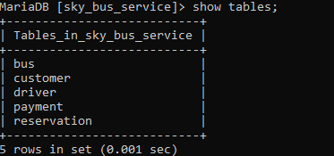
3.DATABASE DESIGN: DATABASES: [sky_bus_service]
1. bus
2. customer 3. driver 4.payment 5. reservation

Slide 5
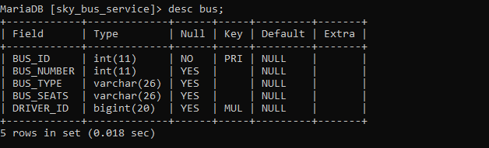
Bus:

Slide 6
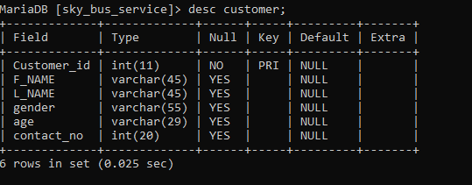
Customer:

Slide 7
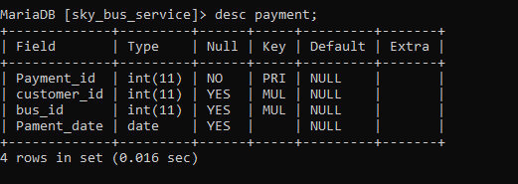
Payment:

Slide 8
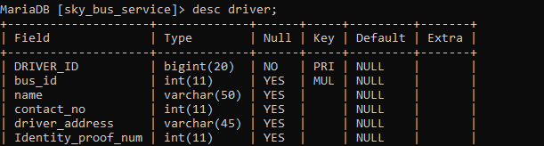
Driver:

Slide 9
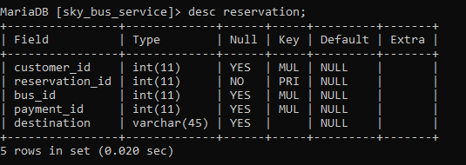
Reservation:

Slide 10
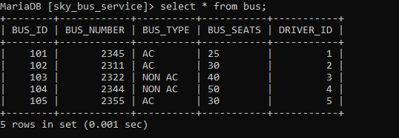
Tables:
Bus:

Slide 11
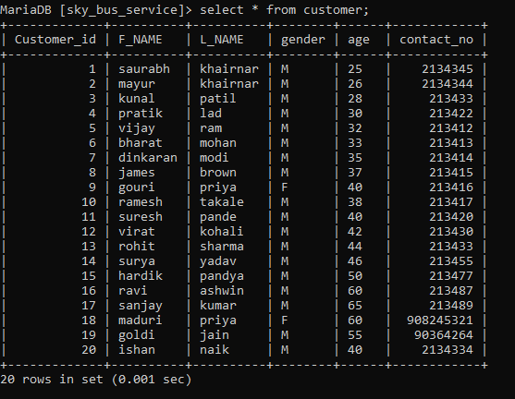
Customer:

Slide 12
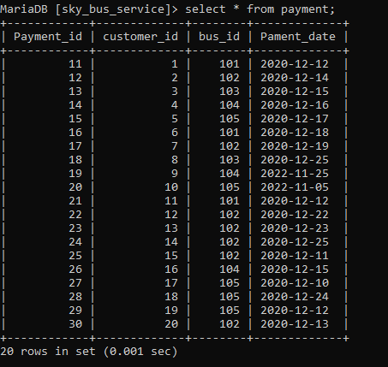
Payment:

Slide 13
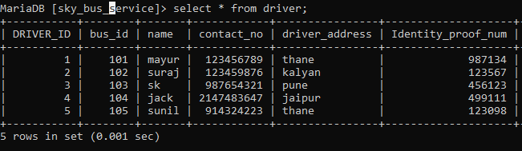
driver:

Slide 14
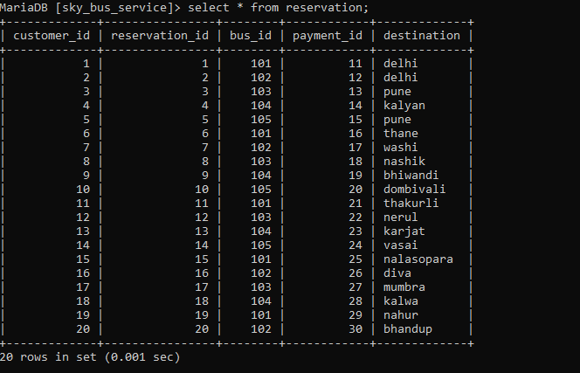
Reservation:

Slide 15
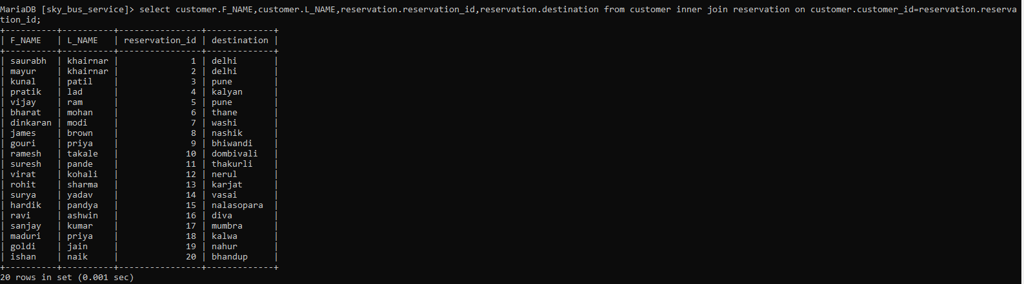
Joins:
1 display customer f name, l name and reservation id and destination.

Slide 16
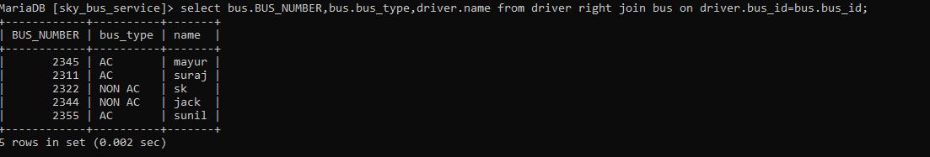
2.Display bus details and driver name

Slide 17
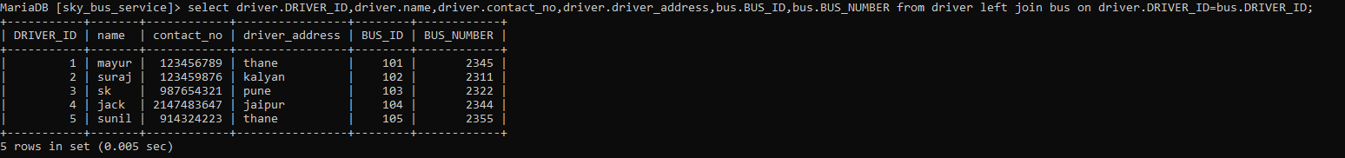
3.DISPLAY driver details

Slide 18
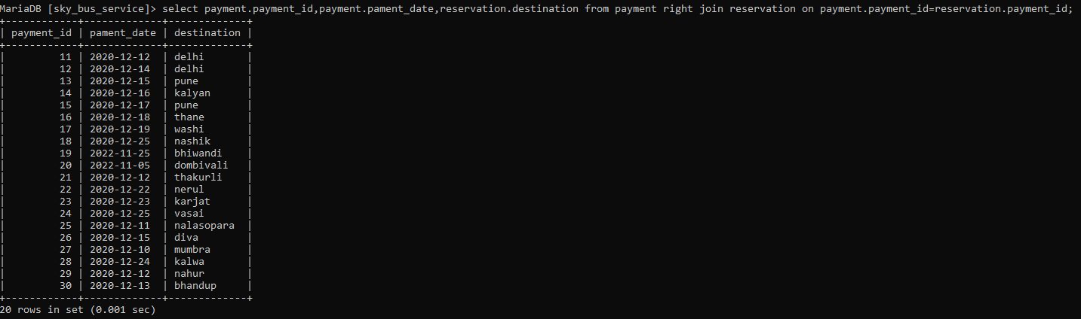
4.Display payment records

Slide 19
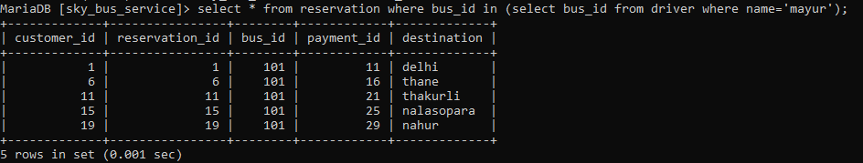
Sub-queries: 1.display all detail driver name= mayur

Slide 20
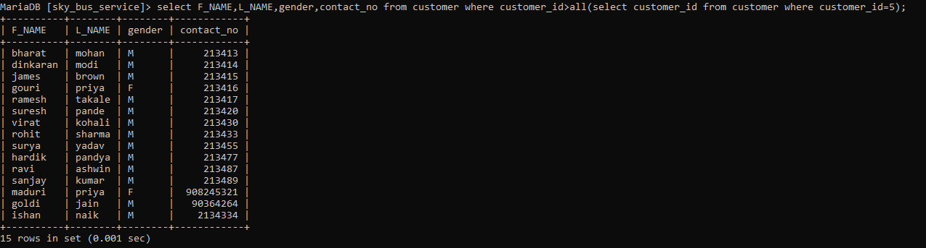
2.Diplay the record customer_id >5

Slide 21
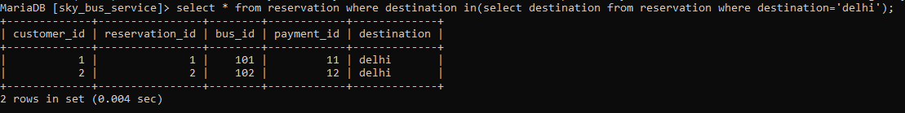
3.Display the customer record who destination is delhi

Slide 22
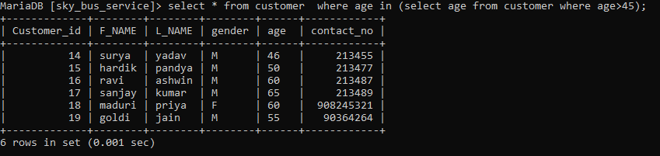
4.Display customer records who age more then 45

Slide 23
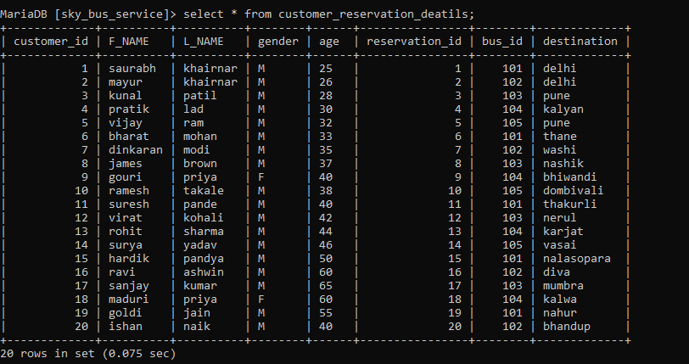
view:

